Slide 1

UG Project -2018
Demand Analysis & Service Enhancement Of Auto Service Inside BHU
Under Supervision of: Dr. P. Bhardwaj Mechanical Engineering
Presented by:
Vikrant Singh Mahawar
Girhe Ankit Gulab
Prabhat Vardhan
Karan Singh Meena
Karam Pal Singh Yadav

Slide 2
Contents
Introduction
Survey Data
Questionnaire
Respective Data
Analysis Of Data And Find Requirements
Flow Diagram
App Interface
Conclusion

Slide 3
Introduction
The objective of our project is to enhance our existing travelling auto services inside BHU, i.e. we are analysing demand of customer for auto from different location inside BHU, analysis of source and destination of their journey. And analysis of demand of auto drivers to increase their daily earnings and reduce uneven distribution. In result, we are trying to develop quality of service time of auto drivers, working on increment of earning of auto drivers, helping them in getting customers.
Our service is bilateral in nature and hence serves both customers and auto drivers. We are developing an android application which will help customers to find auto with less effort and it will also help auto drivers to find customers and increase their income.
Using application the customer will send a request for auto, depending on the position of auto in queue the auto driver will receive a notification, which he will accept on his wish. The customer will provide his source and destination in request. By accepting the request of customer, auto driver will report to the location of source and pick up the customers.

Slide 4
Survey Data
HG SURVEY (20 JAN 2018)
S.no. | Started on | Auto at stand | Coming | Going | Passing
1 | 1:48 pm | 15 | (1) (0) (0)(3) | (5) | (4) (0e) (2)
2 | 1:53 pm | 18 | (2) | (5) (0) | (3)
3 | 1:58 pm | 17 | ----- | (5) | (4) (0) (2)
4 | 2:03 pm | 16 | (1) | -------- | (4) (0) (0) (0) (0) (0)
5 | 2:08 pm | 17 | ------ | (5) | (4) (4) (5)
6 | 2:13 pm | 16 | (1) (0) | (5) (5) (4) | (4) (2) (4)
7 | 2:18 pm | 15 | ------ | ------- | (0)
8 | 2:23 pm | 15 | (2) (2) | (3) (4) | (5) (4)
9 | 2:28 pm | 15 | ----- | ----- | (0) (5)
10 | 2:33 pm | 15 | ----- | (4) (3) | (3) (4) (1) (5)
11 | 2:38 pm | 13 | ----- | (5) | (3,2d) (0) (0)
12 | 2:43 pm | 12 | ----- | (4) | (3)
13 | 2:48 pm | 11 | (1) | (5) (4) | (3) (1) (5)

Slide 5
SOME ADDITIONAL STATEMENT
1:48 pm 1 auto waiting with 1 passenger +1+1+2 go at 1:57 pm. (9 min)
1:58 pm 1 auto waiting with 2 passenger+3 go at 2:01 pm. (3 min)
1:57 pm go and stand in front of SN BOSS
2:01 pm 1 auto waiting with 1 passenger+1+3 go at 2:08 pm. (7 min)
2:09 pm 1 auto waiting with 2 passenger+3 go at 2:15 pm. (6 min)
2:11 pm 1 auto waiting with 4 passenger+1 go at 2:16 pm. (5 min)
2:13 pm 1 auto waiting with 2 passenger+2 go at 2:17 pm. (4 min)
2:17 pm 1 auto waiting with 2 passenger+2 go at 2:26 pm. (9 min)
2:18 pm 1 auto waiting with 2 passenger+2 go at 2:35 pm. (17 min)
2:20 pm 1 auto waiting with 2 passenger+1 go at 2:37 pm. (17 min)
2:36 pm 1 auto waiting with 3 passenger+2 go at 2:39 pm. (3 min)
2:40 pm 1 auto waiting with 1 passenger+3 go at 2:43 pm. (3 min)
2:43 pm 1 auto waiting with 1 passenger+3+1 go at 2:48 pm. (5 min)
2:47 pm 1 auto waiting with 3 passenger+1 go at 2:52 pm. (4 min)

Slide 6
HG SURVEY (20 JAN 2018)

Slide 7
HG ( 29 Jan 2018)

Slide 8
HG ( 31 Jan 2018)

Slide 9
Vishwanath Temple (21 Jan 2018)
S. no. | Started on | Auto at stand | Coming | Going | Passing
1 | 1:43 pm | 7e, 10 | (3) | (0) (5) (3) | (0) (2) (5) (3) (2) (5)
2 | 1:48 pm | 7e, 8 | (5) | (2) (3) (4) | (5) (0e)⁵ (4) (2e) (0,p3)
3 | 1:53 pm | 7e, 6 | (5) (4) | (5) (0) (2) | (3,d1) (3,d1) (4,p1)
4 | 1:58 pm | 7e, 5 | (0e) | ------- | (4) (3) (2,d2)
5 | 2:03 pm | 8e, 5 | (3) (5) (4) | (5e) | (5) (4) (5)
6 | 2:08 pm | 7e, 8 | ------ | (5) | (3,d1) (6,d2) (2) (0,p3)

Slide 10
Vishwanath Temple (13 Jan 2018)
S. no. | Started on | Auto at stand | Coming | Going | Passing
1 | 3:38 pm | 8 | (2) | -------- | (d3) (0)
2 | 3:50 pm | FTC | ----------- | -------- | (3)
3 | 3:55 pm | 6 | ----------- | (3) | (d6e)
4 | 4:00 pm | 5 | (0) | (3) | (0e)
5 | 4:05 pm | FTC | ----------- | --------- | (0)
6 | 4:15 pm | 4 | (3) | (0) | (p2) (d2) (d5)
7 | 4:20 pm | FTC | ---------- | (4) | -----------
8 | 4:25 pm | 5 | (0) (0) | (2e) (4) | (d2) (d3)
9 | 4:35 pm | 5 | (0) (0) (0) | (4) | -----------
10 | 4:40 pm | FTC | ------------ | (1) (0e) | (0)

Slide 11
Vishwanath Temple (31 Jan 2018)
S. no. | Started on | Auto at stand | Coming | Going | Passing
1 | 2:35 pm | 5e , 1 | (0) (0) (0) | (4) | (5) (5)(4) (5e) (3,1d)
2 | 2:40 pm | 5e, 3 | (3) (0) (0) (0) (2) | (4) (5) (4) | (1)
3 | 2:45 pm | 5e, 5 | (5) | (3) (5e) (5) (7e) (5e) (5) (9e) (0) (3) | (5) (5,d3) (5e)
4 | 2:50 pm | 1e, 1 | (5)(4) (0e) (5) (4) | (5) (5e) | (0,3p) (5)
5 | 2:55 pm | 1e, 4 | (2) (0) (3e) | (4) (1re) | (3,1d) (4,1d)
6 | 3:00 pm | 2e, 4 | (0) | (5) (5e) (5) | (4) (2)
7 | 3:05 pm | 1e, 3 | (5) (0) (2) | (5) (5) | (2,3p)
8 | 3:10 pm | 1e, 4 | ----------- | (2) (6) (2) | (2,2p) (0,3p) (5) (2) (4) (0) (5,2d)
9 | 3:15 pm | 1e, 1 | (3) (0) (4) (3) (1e) | (6) (3) | (3) (2,2d) (3)
10 | 3:20 pm | 2e, 3 | (10e) | (0) (3) (5) (1re) (6) | (5,2d) (5) (3) (2) (0e) (6)

Slide 12
LANKA GATE (22 Jan 2018)
S. no. | Started on | Auto at stand | Coming | Going | Passing
1 | 3:42 pm | 5e, 4 | (4) (5) (6) (4) (4e) (7) (4) (5) | (3) (6) (4) (4) (5) (4e) (5) (4) (4e) (6e) | (5) (7) (5)
2 | 3:47 pm | 3e, 4 | (5)(0) (6) (5) (5) | (4) (2e) (5) (5) (0) | (5) (6) (8e) (0e) (0e)
3 | 3:52 pm | 2e, 5 | (5) (5) (5) (5) (5) (5) (2) | (0) (3) (0) (0) (1) (4) (5) | (0)
4 | 3:57 pm | 2e, 6 | (5) (5e) (0) (2) (5e) | (1) (2) (4e) (5e) (4) (4e) (2) (3) (4e) (5)
5 | 4:02 pm | 1e, 3 | (3) (0) (3) (3) | (4) (5) | (4e) (1) (5)
6 | 4:07 pm | 1e, 5 | (0) | -------- | --------

Slide 13
Vishwanath Temple(13 Jan 2018)

Slide 14
Vishwanath Temple(21 Jan 2018)

Slide 15
Vishwanath Temple(31Jan 2018)

Slide 16
SHEER GATE (21 Jan 2018)
4:13 PM to 4:42 PM
There was not any single auto present
There were 6 riksha there.
Five got customer in half hour.
Health Centre (20 JAN 2018)
From 3:14 PM to 3:50 PM only three auto passes.
No one comes to health centre that day (Saturday)

Slide 17
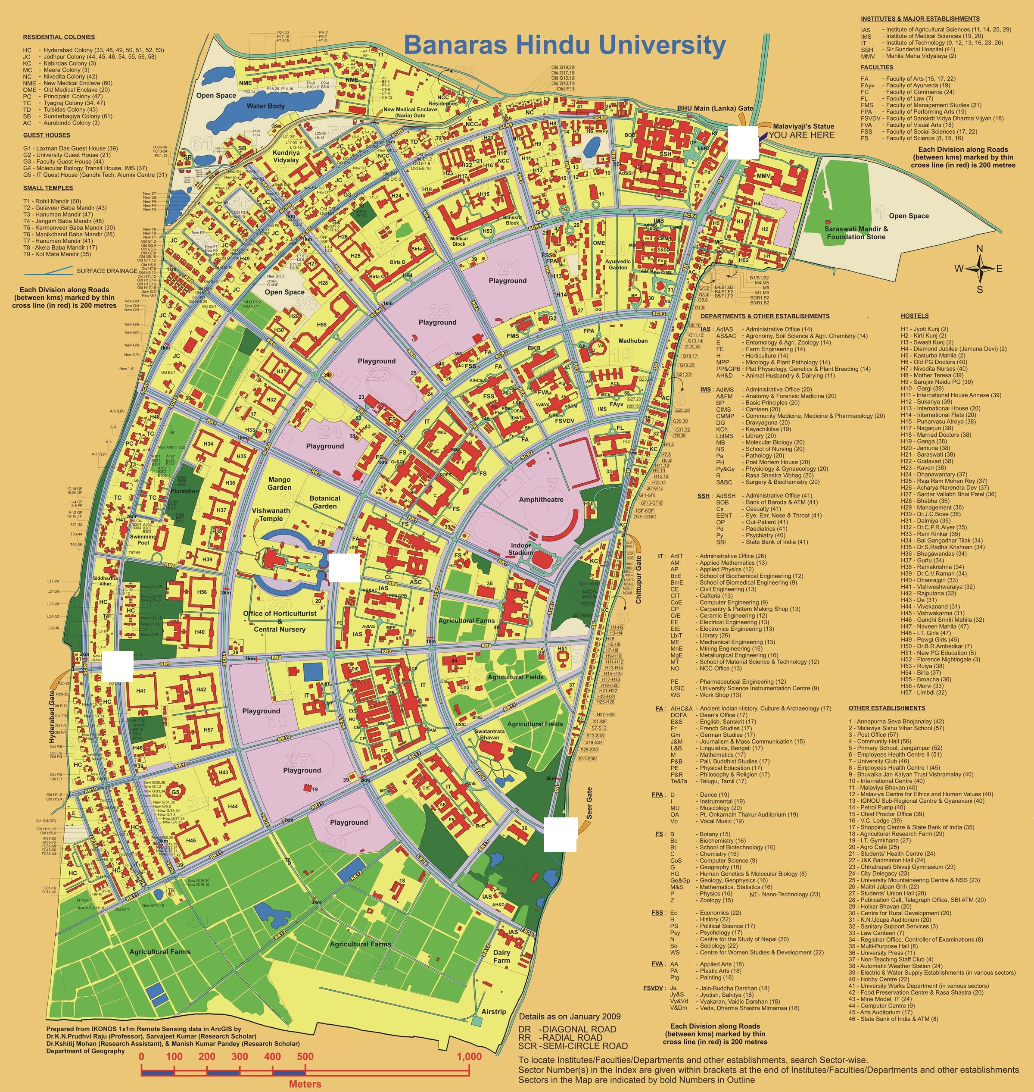

Slide 18
Questionnaire
We designed a questionnaire to know about auto drivers, their daily routines and problems faced by them, which gave us knowledge about their daily income, their income sources, android users, their service time.
Questionnaire consist their personal information
Several questions

Slide 19
Related with him.
Are you satisfied with income?
Is your income completely dependent on Auto?
Are you literate?
Related with Auto.
Does auto belongs to you?
If doesn’t belong, what is rent?
If yes, have you taken loan for auto?
Related to App.
Are you an android user?
Do you want to use App?
Related to Service.
What is your service time ?
How many rounds do you make per day?
From where do you pick passenger?
From where do you drop passenger?
At what time of day you ever make more profit?
How many times you go reserved?
What is time span between two trip?
How many time you make trip with less than 5 customers?
Related to income.
How much do you spend on fuel per day?
How much your income per day?

Slide 20
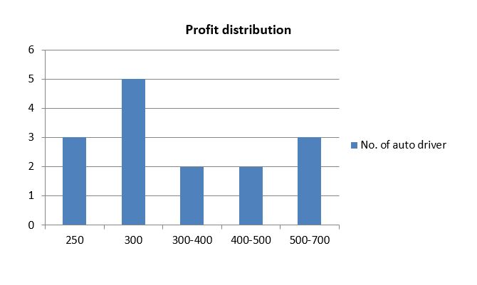
Result from questionnaire
Profit distribution at Hyderabad gate
Average profit of auto drivers: Rs. 375 (approximately)

Slide 21
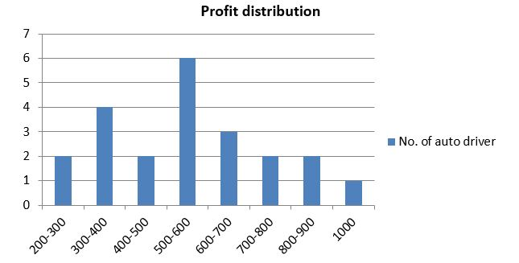
Result from questionnaire
Profit distribution at Vishwanath Temple
Average profit of auto drivers: Rs. 520 (approximately)

Slide 22
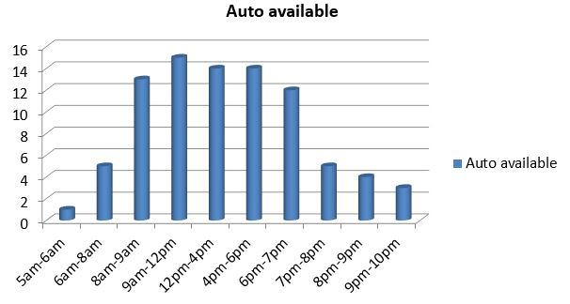
Result from questionnaire
Availability of auto at HG
Maximum number of auto are available in between 8AM to 7PM

Slide 23
Result from questionnaire
Android Users at HG
33.33%

Slide 24
Result from questionnaire
Android Users at VT

Slide 25
Rounds of drivers at VT

Slide 26
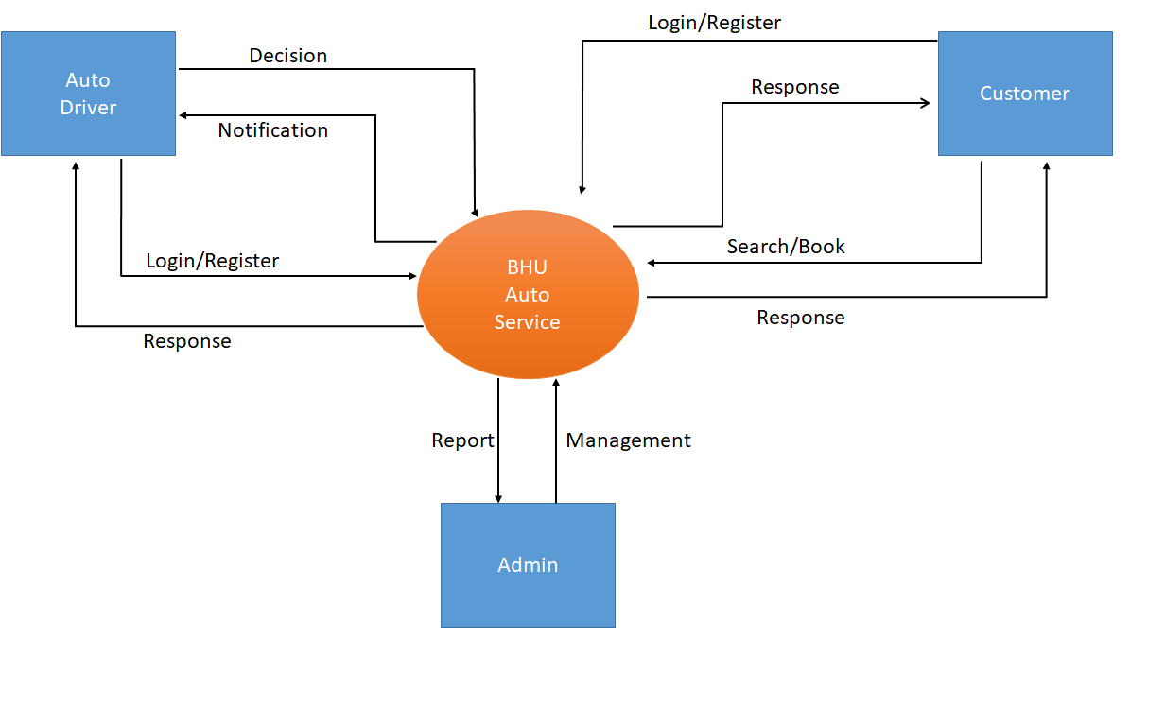
Flow Diagram
0 Level Flow Diagram

Slide 27
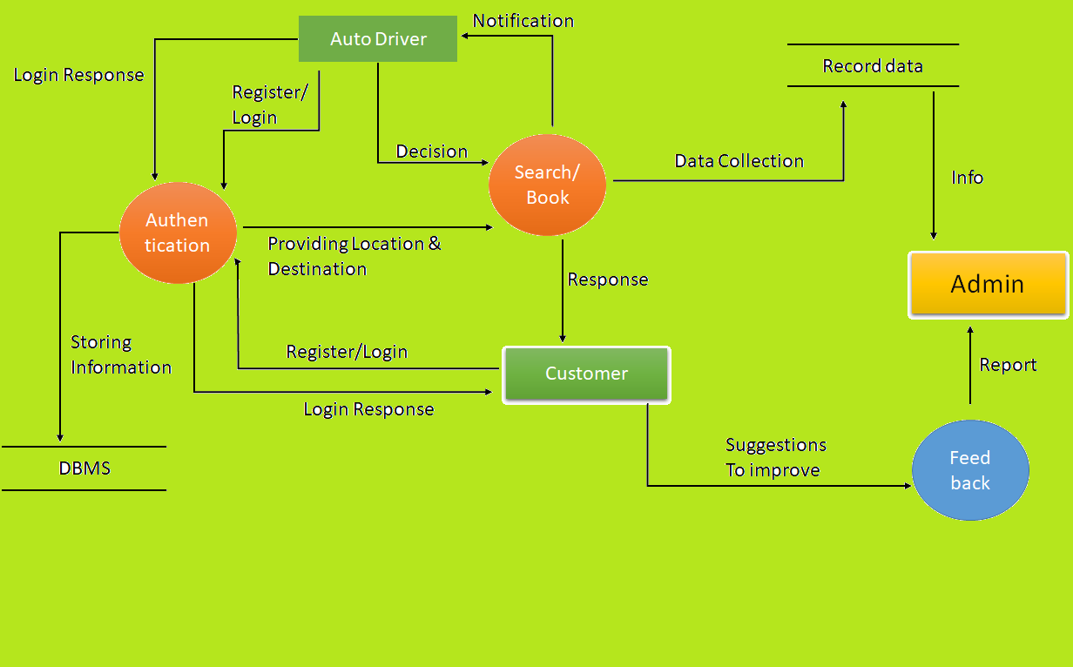
1 Level Flow Diagram

Slide 28
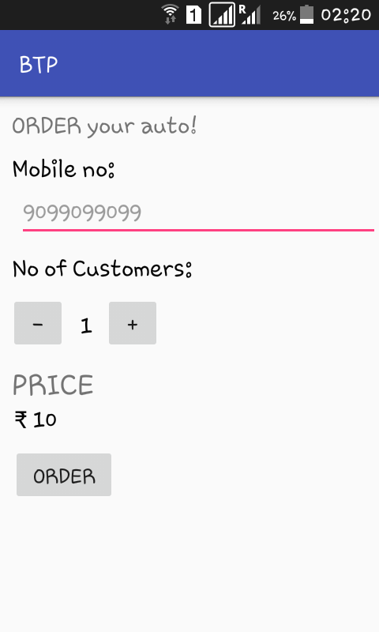
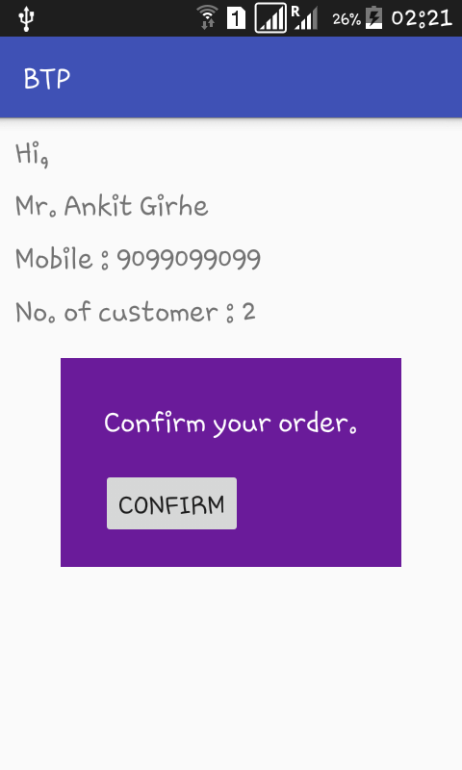
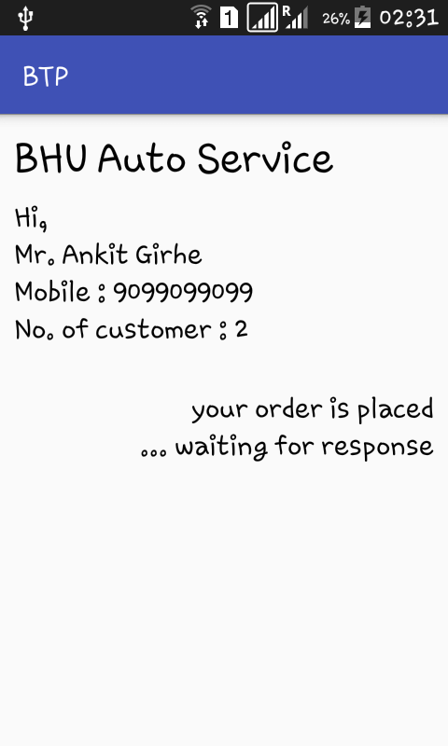
App Interface

Slide 29
Conclusion
From this project we can analyse data, from different location of BHU. Every request obtained in app will be stored in database, the data will be used to forecast that in what time of day, from which location and how many customers are ordering auto. By getting this information we will be able to analyse that demand, then we can send auto there for those time so that the service will be improved.
There will be significant reduction of traffic at auto station,
There will be no wastage of time for going from hostel/ location of user to auto station.
The system will be more organised.

Slide 30
Benefits of App
Customer : 1) Timing
2) Reduced effort
3) Reliable
Auto Driver : 1) Timing
2) Systematic way
3) Benefits on occasion (Saturday, events, festivals)

Slide 31
Thank You!

